Slide 1
topicFive
HTML Hyperlinks

Slide 2
Learning Objectives
At the end of this chapter the students should be able to:
Creating different kinds of links.
Use image to link to another page.
Use image mapping and other types of links
Differentiate between relative and absolute links

Slide 3
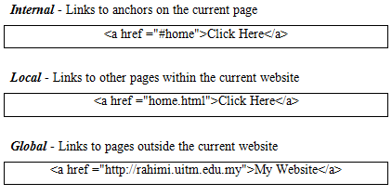
Introduction
Links are the most fundamental part of the World Wide Web.
It is the links that tie it all together.
There are three different kinds of links you can have on your website:

Slide 4
Introduction
It is possible to make texts and images work as links.
With a little creativity other objects, such as pushbuttons or even drop-down menus can work as links as well.

Slide 5
Introduction
The <a> tag is used to create an anchor to link from, the href attribute is used to address the document to link to, and the words between the open and close of the anchor tag will be displayed as a hyperlink.

Slide 6
Relative and Absolute link
When creating links, we need to reference the files with each file's location, known as file's path.
HTML supports two kinds of file paths: relative and absolute.
A relative path refers to a file's location that is relative to the folder in which the file is in.
A relative link is the easiest kind of link to create since you only need to reference the file name because the file is in the same directory

Slide 7
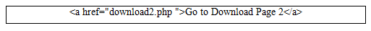
Relative and Absolute link
Let say on http://kelantan.uitm.edu.my website there is folder called download and it has two web page files saved as: download1.php and download2.php.
To create a link in download1.php to the download2.php file, we will use just the filename.
Specifically, link tag will look something like:

Slide 8
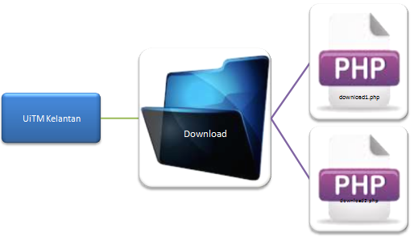
Example 1

Slide 9
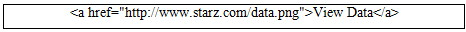
Relative and Absolute link
An absolute link shows the entire destination address in the link tag.
This exact destination address is referred to as an absolute path.
You might be thinking why cannot we use just the file name or just the relative path?
Well, the relative is only good for linking to files that are in the current folder.
To link to files which are outside of the current folder, an absolute path needs to be used.

Slide 10
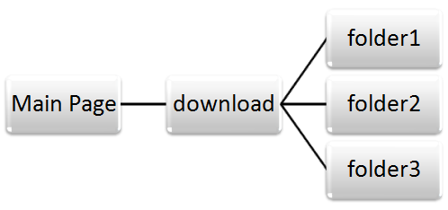
Example 2

Slide 11
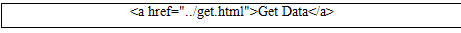
Example 2
Let’s say you have an HTML file in folder1: view.html.
The file contains a link to a download folder: get.html; which one level higher compare to folder1.
To link the file together:

Slide 12
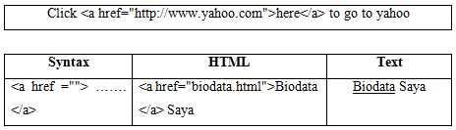
Creating Links To Another Web Page and Anchor
The tags used to produce links are the <a> and </a>.
The <a> tells where the link should start and the </a> indicates where the link ends.
Everything between these two will work as a link.
The target of the link is added to the <a> tag using the href="index.html" setting.
The example below shows how to make the word here work as a link to yahoo.

Slide 13
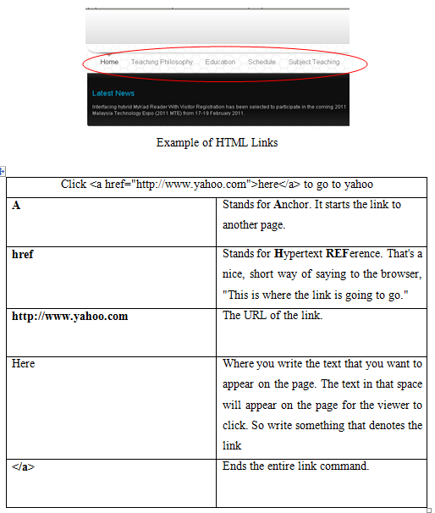

Slide 14
Define Colors for links
There are a few settings that can be useful for controlling the colors of text links:
Define colors for all links on the page.
Define colors for individual links on the page.

Slide 15
Define colors for all links on the page
The general color of text links is specified in the <body> tag, like in the example below:
link - standard link - to a page the visitor hasn't been to yet. (standard color is blue - #0000FF).
vlink - visited link - to a page the visitor has been to before. (standard color is purple - #800080).
alink - active link - the color of the link when the mouse is on it. (standard color is red - #FF0000).

Slide 16
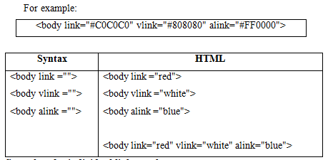

Slide 17
Define colors for individual links on the page
The method described above is for setting overall link colors for the page.
However, you might want one or more links to have different colors than the rest of the page.
There are two techniques for doing this:
Placing font tags between the <a href> and the </a> tag. This method will work on all browsers except MSIE 3.
Using a style setting in the <a> tag. This method works on MSIE3 and newer browsers.

Slide 18
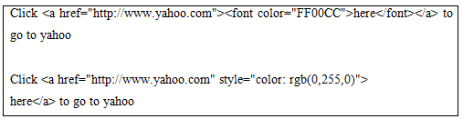

Slide 19
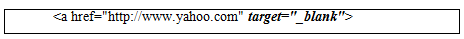
Target
By default, links will open in the current window or frame.
You need to add a target if you want the link to open in another window or frame than the link itself is placed in.
To do this you simply add a target="" attribute to the <a href> tag.
This example will open yahoo website in a new window

Slide 20
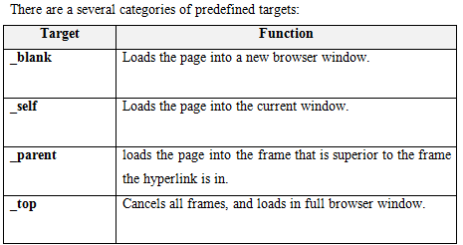

Slide 21
Target
In addition to these, you can also enter the name of a frame window if your page is within a frameset.
With the target attribute, you can define where the linked document will be opened.

Slide 22
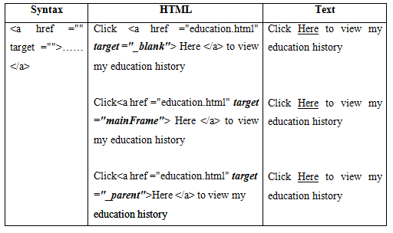

Slide 23
No Underline
Each HTML links will have an underline to indicate that the text/images are hyperlinks.
For some reason we might want to remove those underline.
This can be done using cascading style sheet.

Slide 24
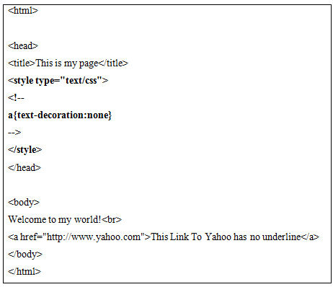

Slide 25
No Underline
Instead of just turning off the underline on all links you could be more specific in defining the way you want your links to work.
In the example below underlining is turned off for all links.
The a:hover tells the browser that when the mouse is over a link the underline should appear.

Slide 26
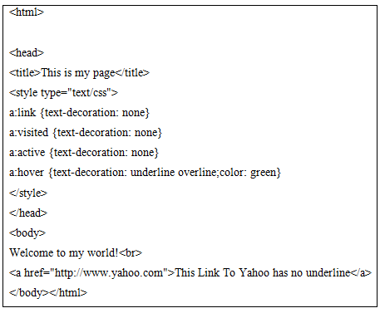

Slide 27
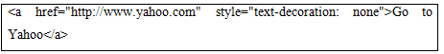
No Underline
If you want to turn off the effect for just a single link, add a style property to the <a href> tag

Slide 28
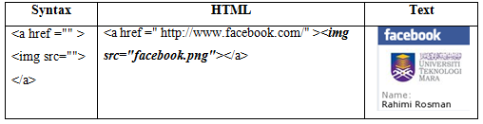
Image Links
If you want to make an image work as a link, the method is exactly the same as with texts.
You simply place the <a href> and the </a> tags on each side of the image.

Slide 29
Link Within a Page (Anchor link)
Linking to anchors is very similar to normal links.
Normal links always point to the top of a page while anchors point to a place within a page.
A # in front of a link location specifies that the link is pointing to an anchor on a page.
Anchor is a specific place in the middle of your page

Slide 30
Link Within a Page (Anchor link)
Simply put, an anchor is a hyperlink that sends your reader to another section of the same web page as itself.
Although links normally go to other sections of your web "site" or even to another site all together, links can also be used to create special shortcuts within your web pages.

Slide 31
Link Within a Page (Anchor link)
Furthermore, you can use anchors as a "jump" ahead on your page for readers who are in a hurry, and wish to sign up for your offer or purchase your products.
For example, you may have a lengthy presentation that sales really well on your site, but there are always those readers who wish to get right to the price and buy.
For these types of readers, you can create an anchor that jumps to the product options on your web page and skips the lengthy presentation

Slide 32
Link Within a Page (Anchor link)
Anchors can be used as a guide to your menu bar.
You may wish to lead your readers back to the menu bar of your page so they can visit other sections of your site.
You can use an anchor to link to your menu bar from anywhere on your web page.
Moreover, you can use an anchor to lead your visitors back to the top of your page.
We just need to create a hyperlink at various places in the page.
If you have a lengthy web page, this saves readers the time of scrolling all the way back to the top of your page

Slide 33
Link Within a Page (Anchor link)
To link to an anchor you need to:
Create a link pointing to the anchor.
Create the anchor itself

Slide 34
Link Within a Page (Anchor link)
The name attribute is used to create a named anchor.
When using named anchors we can create links that can jump directly into a specific section on a page, instead of letting the user scroll around to find what he/she is looking for.
Anchor is usually used for FAQ.

Slide 35
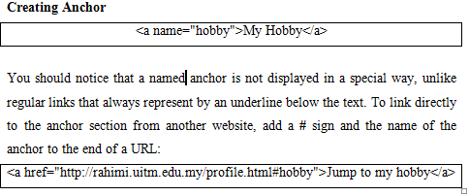

Slide 36
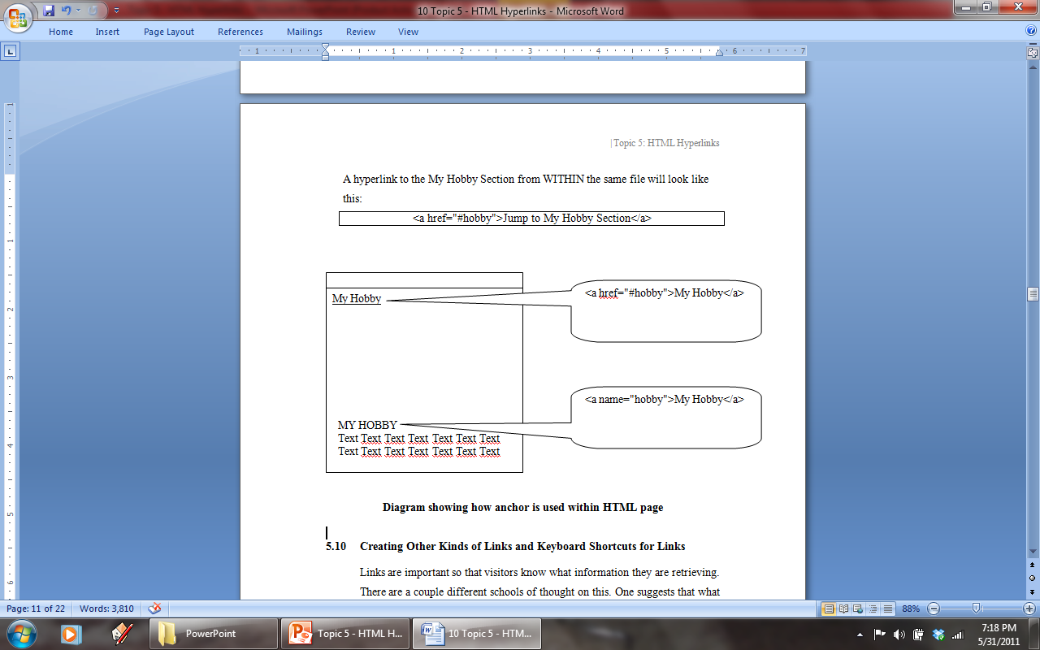
Link Within a Page (Anchor link)
A hyperlink to the My Hobby Section from WITHIN the same file will look like this:

Slide 37
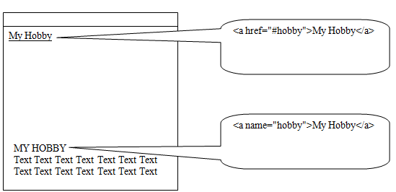

Slide 38
Creating Other Kinds of Links and Keyboard Shortcuts for Links
Links are important so that visitors know what information they are retrieving.
There are a couple different schools of thought on this.
One suggests that what you write for links should be quite blatant.
This includes text like "Click here for this" or "Here's a link to".

Slide 39
Creating Other Kinds of Links and Keyboard Shortcuts for Links
The other states that since the hypertext links will be blue the links should be just another word in the text set up as a link.
In reality it depends what you're doing.
If you're building a menu bar down the side of your page then the last thing you want is for every single link to say "Click here for HTML Introduction Page", simply because your menu would be as wide as your page.

Slide 40
Creating Other Kinds of Links and Keyboard Shortcuts for Links
For accessibility reasons you should try to make sure your links make sense out of context, such as “Home”, “Biodata”, “Family” and so on

Slide 41
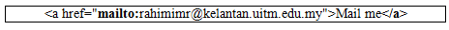
Email Link
Having a link that allows visitors to send email from your website can be a great addition to your site, making it easy for your visitors to send questions or comments.
This function is essential for the future development and enhancement of the website.
The mailto: command is added into href attribute.
It follows the same coding scheme as the hypertext link above.
This format place a blue wording on the screen that people can click to send you an e-mail.

Slide 42
Email Link
Notice that it's the same format as a link except in this link you write "mailto:" in place of the http:// and you place your e-mail address in place of the page URL.
Please notice there is NO SPACE between the colon and the e-mail address.

Slide 43
Email Link
However, please be very careful when using this option, for two reasons:
If the person only has a web-based email account, and hasn't configured an email program on their computer then it will open their email program for the first time and try to walk them through setting it up. This isn't a good idea if they're new to computers.
There are now little programs called 'bots' which wander round the internet looking for email addresses to send spam to. If you don't want to receive them, then one part of the solution is not publishing your email address on the internet. So think long and hard before you use a mailto. A web-based form that they can fill out is more secure and works just as well.

Slide 44
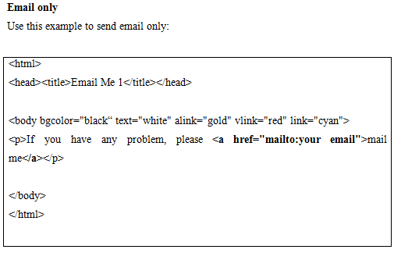

Slide 45
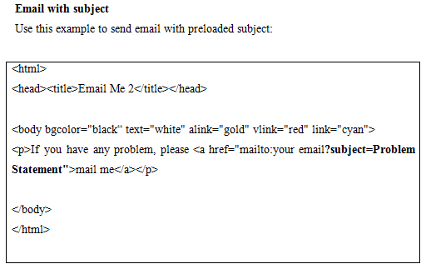

Slide 46
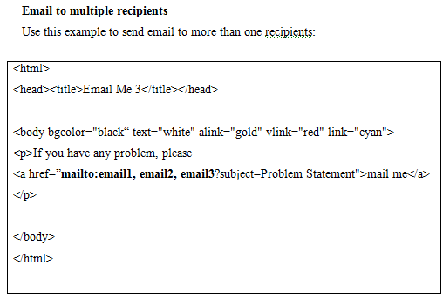

Slide 47
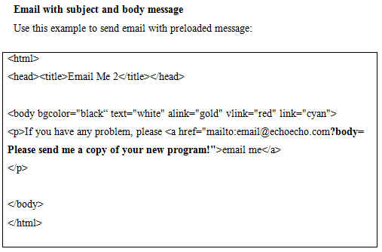

Slide 48
Adding keyboard shortcuts to links (accesskey)
With the accesskey attribute, you can assign keyboard shortcuts to links.
The idea behind creating keyboard shortcuts is to simply allow the user to quickly visit a page by using the access keys value corresponding to the link.
In Windows, use ALT-X where X represents a numerical value assigned with accesskey attribute keys from the keyboard to open the desired link

Slide 49
When defining keyboard shortcuts for links, make sure you include the keyboard shortcuts next to each link.
If, however, you do not display the keyboard shortcuts, user won't know you have defined keyboard shortcuts.
Thus users cannot use those shortcuts for links.
The following shows how to use the accesskey to define keyboard shortcuts to links:

Slide 50
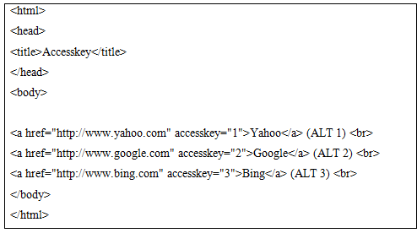

Slide 51
Setting tab order of links
To help users who cannot use mouse, the tabindex attribute can be added to the anchor tag to use specific tab order of links.
When you customize the order of links, browsers generally highlight each link, from top to bottom of the web page, each time the tab key is pressed.
Once a link is selected and highlighted, the user can press ENTER or RETURN key to visit the selected page.
The following shows a link selected with a TAB key:

Slide 52
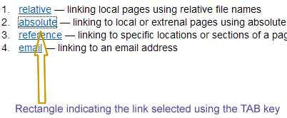

Slide 53


Slide 54
Dividing an Image into Clickable Regions/ Image Maps
If you want to add some interactivity to your images, you may consider using image maps.
With image maps, you can define multiple clickable regions on a single graphic.
To define clickable regions on a single image, set up hotspots within a single image

Slide 55
Dividing an Image into Clickable Regions/ Image Maps
A hotspot is a defined area on an image that acts as a hypertext link.
The hotspots are defined through the use of image maps.
Image maps list the coordinates that define the boundaries of the hotspots or the regions that act as hypertext links on an image

Slide 56
Dividing an Image into Clickable Regions/ Image Maps
The whole idea behind using image maps is to link one image to multiple destinations.
Previously we discuss how to link one image to just one destination.
On this page, you will learn how to create image maps or multiple hyperlinks on a single image.

Slide 57
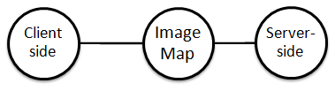
Dividing an Image into Clickable Regions/ Image Maps
There are two types of image maps:

Slide 58
Server-side image maps
In a server-side image map, the server controls the image map.
A server is a computer that store web pages and serves those pages when a client requests a page.
When we use a server-side image map, we define the coordinates of the hotspots in a server-side script.
Whenever a user clicks on a hotspot on an inline image, the appropriate coordinates are sent back to the server to activate the appropriate hyperlink

Slide 59
Server-side image maps
One of the main drawbacks of using server-side image map is that server-side image maps can be slow to operate.
This is so because every time a user clicks on an inline image map, that information has to be sent to the server and then the server has to process that request

Slide 60
Client-side image maps
In a client-side image map, the image map is defined in an HTML file and that is processed by the browser locally.
Because client-side image maps are processed locally, they tend to be more responsive than server-side image maps.
Thus client-side image maps can be tested using a local computer; whereas, to test the server-side image maps, we need a server

Slide 61
Dividing an Image into Clickable Regions/ Image Maps
There are two easy steps to create an image map:
define image map hotspots
use the image map

Slide 62
Defining image map hotspots
To create image an image map, you need coordinates of the points corresponding to the hotspot boundaries.
In other words, you will define an area, by using coordinates, for each hyperlink that you want on an inline image.

Slide 63
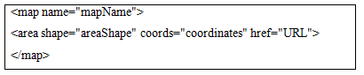
Defining image map hotspots
To find coordinates for a specific area for an image, you will need a special program that shows you coordinate.
As an example, Macromedia's Dreamweaver 2004 allows you to create image maps by letting you draw the areas on an image.
For each area you draw, the program will write the appropriate coordinates in your web page code file.
The general syntax for an image map tag is:

Slide 64
So an image map is defined with the <map> tag.
The name attribute inside the <map> tag gives a name to the image map.
To be able to use an image map, we must assign a name to an image map.
Within the <map> tag, we use the <area> tag to specify the areas of the image that will act as hotspots.
We can include as many <area> tags within the <map> tag we choose.
Each of the <area> tag will act as a separate hyperlink.

Slide 65
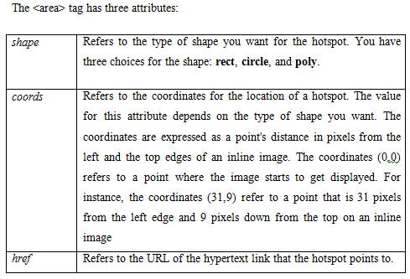

Slide 66
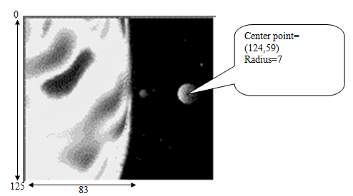

Slide 67
Creating a rectangular hotspot
To define a rectangular hotspot, you have to define two points: the upper-left corner and the lower-right corner.
For example, if we want to create a map for the suns, the coordinate for the upper-left corner coordinates are (0, 0) and the lower-right corner coordinates are (83, 125).
The easiest way to get the coordinate is by using the Paint software:

Slide 68
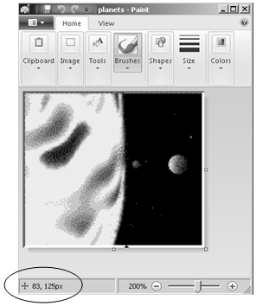

Slide 69
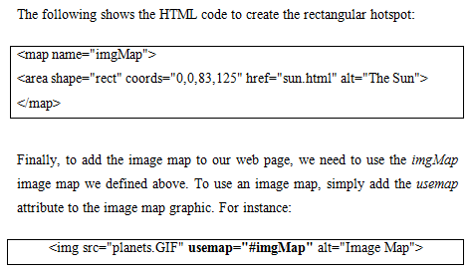

Slide 70
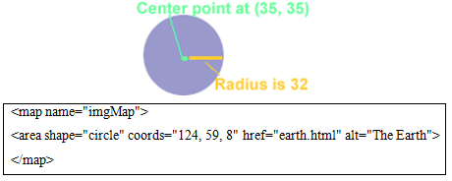
Creating a circular hotspot
The coordinates required for creating a circular hotspot differ from those of a rectangular hotspot.
A circular hotspot is defined by the locations of its center and its radius

Slide 71
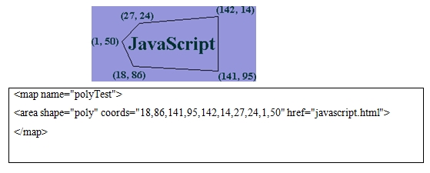
Creating a polygonal hotspot
For irregular shaped images, you can use the polygon hotspot.
To create a polygon hotspot, use the poly value for the shape attribute.
Just like we did with the rectangular and circular hotspots, we supply the coordinate values for the desired place of hotspot on an image

